Slide 1
MEDICAL DATA HISTORY – SQL ANALYSIS
Real-Time Medical Database Analysis using MySQL
Prepared By
Shaik Mezher Basha
Project ID : PRSQL-02
Team ID : PTID-CDA-DEC-25-961
Domain : Healthcare Data Analysis
Tool Used : MySQL
Email ID : shaikmezher@gmail.com

Slide 2
PROJECT INFORMATION
Project Title : Medical Data History – SQL Analysis
Project Type : Real-Time Medical Data Analysis
Domain : Healthcare Data
Database : MySQL
Language : SQL
Description :
This project analyzes medical data using SQL to find useful information about patients, hospital admissions, and diagnoses. It uses real-world SQL queries on a healthcare database to retrieve and understand data in a simple and effective way.

Slide 3
PROJECT OBJECTIVES
• To understand and work with a real-time medical database
• To apply SQL queries for data retrieval and analysis
• To analyze patient, admission, and diagnosis information
• To practice joins, filtering, and aggregation in SQL
• To gain hands-on experience with healthcare data analysis

Slide 4
DATASET OVERVIEW
The project uses a relational medical database consisting of
multiple interrelated tables.
• Patients – Stores patient personal and medical details
• Admissions – Contains hospital admission and diagnosis data
• Doctors – Includes doctor information and specialties
• Provinces – Stores province and location details
These tables are connected using primary and foreign keys,
forming a structured healthcare database.

Slide 5
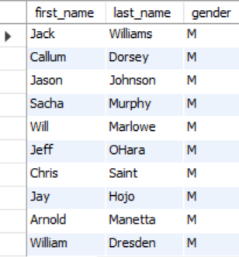
MEDICAL DATA HISTORY – SQL ANALYSIS
Show first name, last name, and gender of patients who's gender is ‘M’
Query
Out Put
SELECT first_name, last_name, gender
FROM patients
WHERE gender = 'M';

Slide 6
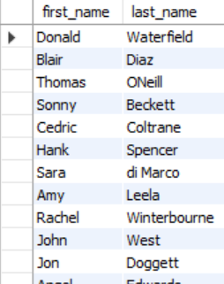
MEDICAL DATA HISTORY – SQL ANALYSIS
Show first name and last name of patients who does not have allergies.
Query
Out Put
SELECT first_name, last_name
FROM patients
WHERE allergies IS NULL;

Slide 7
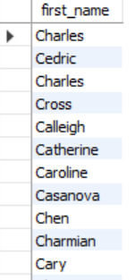
MEDICAL DATA HISTORY – SQL ANALYSIS
Show first name of patients that start with the letter ‘C’
Query
Out Put
SELECT first_name
FROM patients
WHERE first_name LIKE 'C%';

Slide 8
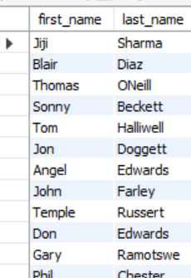
MEDICAL DATA HISTORY – SQL ANALYSIS
Show first name and last name of patients that weight within the range of 100 to 120 (inclusive)
Query
Out Put
SELECT first_name, last_name
FROM patients
WHERE weight BETWEEN 100 AND 120;

Slide 9
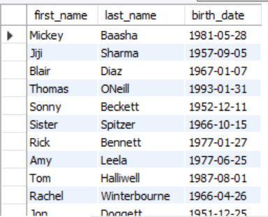
MEDICAL DATA HISTORY – SQL ANALYSIS
Show first name and last name concatenated into one column to show their full name
Query
Out Put
SELECT CONCAT(first_name, ' ', last_name) AS full_name
FROM patients;

Slide 10

MEDICAL DATA HISTORY – SQL ANALYSIS
Show how many patients have a birth_date with 2010 as the birth year.
Query
Out Put
SELECT COUNT(*) AS total_patients
FROM patients
WHERE YEAR(birth_date) = 2010;

Slide 11

MEDICAL DATA HISTORY – SQL ANALYSIS
Show the first_name, last_name, and height of the patient with the greatest height.
Query
Out Put
SELECT first_name, last_name, height
FROM patientsORDER BY height DESC
LIMIT 1;

Slide 12
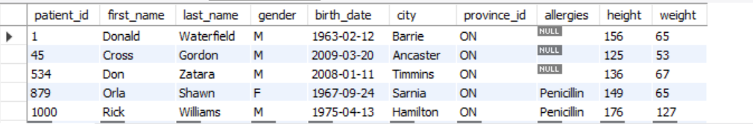
MEDICAL DATA HISTORY – SQL ANALYSIS
Show all columns for patients who have one of the following patient_ids: 1,45,534,879,1000
Query
SELECT *
FROM patients
WHERE patient_id IN (1, 45, 534, 879, 1000);
Out Put

Slide 13

MEDICAL DATA HISTORY – SQL ANALYSIS
Show the total number of admissions
Query
Out Put
SELECT COUNT(*) AS total_admissions
FROM admissions;

Slide 14
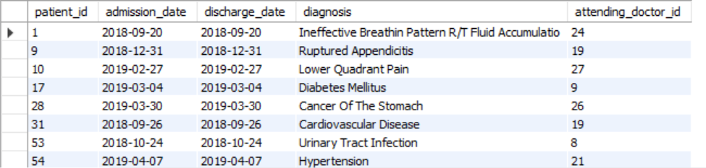
MEDICAL DATA HISTORY – SQL ANALYSIS
Show all the columns from admissions where the patient was admitted and discharged on the same day.
Query
SELECT *
FROM admissions
WHERE admission_date = discharge_date;
Out Put

Slide 15

MEDICAL DATA HISTORY – SQL ANALYSIS
Show the total number of admissions for patient_id 579.
Query
Out Put
SELECT COUNT(*) AS total_admissions
FROM admissions
WHERE patient_id = 579;

Slide 16
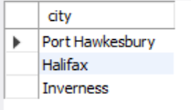
MEDICAL DATA HISTORY – SQL ANALYSIS
Based on the cities that our patients live in, show unique cities that are in province_id 'NS’?
Query
Out Put
SELECT DISTINCT city
FROM patients
WHERE province_id = 'NS';

Slide 17
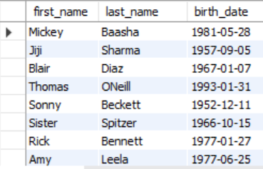
MEDICAL DATA HISTORY – SQL ANALYSIS
Write a query to find the first_name, last name and birth date of patients who have height more than 160 and weight more than 70
Query
Out Put
SELECT first_name, last_name, birth_date
FROM patients
WHERE height > 160 AND weight > 70

Slide 18
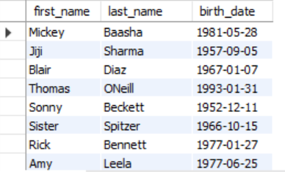
MEDICAL DATA HISTORY – SQL ANALYSIS
Show unique birth years from patients and order them by ascending.
Query
Out Put
SELECT DISTINCT YEAR(birth_date) AS birth_year
FROM patients
ORDER BY birth_year ASC;

Slide 19
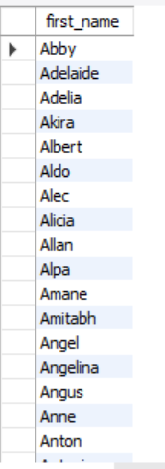
MEDICAL DATA HISTORY – SQL ANALYSIS
Show unique first names from the patients table which only occurs once in the list.
Query
Out Put
SELECT first_name
FROM patients
GROUP BY first_name
HAVING COUNT(first_name)=1;

Slide 20
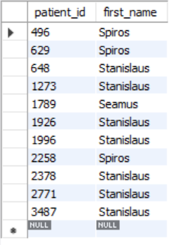
MEDICAL DATA HISTORY – SQL ANALYSIS
Show patient_id and first_name from patients where their first_name start and ends with 's' and is at least 6 characters long.
Query
Out Put
SELECT patient_id, first_name
FROM patients
WHERE first_name LIKE 's%s’
AND LENGTH(first_name)>=6;

Slide 21
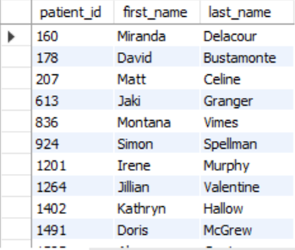
MEDICAL DATA HISTORY – SQL ANALYSIS
Show patient_id, first_name, last_name from patients whos diagnosis is 'Dementia'. Primary diagnosis is stored in the admissions table.
Query
Out Put
SELECT p.patient_id, p.first_name, p.last_name
FROM patients p
JOIN admissions a
ON p.patient_id = a.patient_id
where a.diagnosis = 'Dementia';

Slide 22
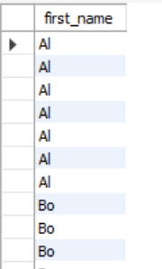
MEDICAL DATA HISTORY – SQL ANALYSIS
Display every patient's first_name. Order the list by the length of each name and then by alphbetically.
Query
Out Put
SELECT first_name
FROM patients
ORDER BY length(first_name),first_name

Slide 23

MEDICAL DATA HISTORY – SQL ANALYSIS
Show the total amount of male patients and the total amount of female patients in the patients table. Display the two results in the same row
Query
Out Put
SELECT
SUM(CASE WHEN gender = 'M' THEN 1 ELSE 0 END) AS male_count,
SUM(CASE WHEN gender = 'F' THEN 1 ELSE 0 END) AS female_count
from patients;

Slide 24
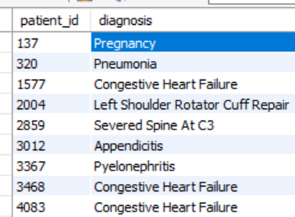
MEDICAL DATA HISTORY – SQL ANALYSIS
Show patient_id, diagnosis from admissions. Find patients admitted multiple times for the same diagnosis.
Query
Out Put
SELECT patient_id, diagnosis FROM admissions
GROUP BY patient_id, diagnosis
having count(*)>1;

Slide 25
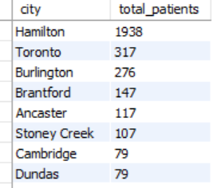
MEDICAL DATA HISTORY – SQL ANALYSIS
Show the city and the total number of patients in the city. Order from most to least patients and then by city name ascending.
Query
Out Put
SELECT city, COUNT(*) AS total_patients
FROM patients
GROUP BY city
ORDER BY total_patients DESC, city ASC;

Slide 26
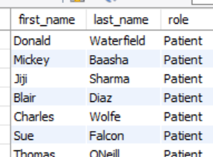
MEDICAL DATA HISTORY – SQL ANALYSIS
Show first name, last name and role of every person that is either patient or doctor. The roles are either "Patient" or "Doctor"
Query
Out Put
SELECT first_name, last_name, 'Patient' AS role
FROM patients
UNION
SELECT first_name, last_name, 'Doctor' AS role
from doctors;

Slide 27
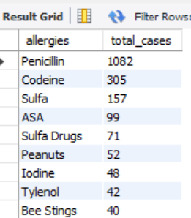
MEDICAL DATA HISTORY – SQL ANALYSIS
Show all allergies ordered by popularity. Remove NULL values from query.
Query
Out Put
select allergies,count(*) as total_cases
from patients
where allergies is not null
group by allergies
order by total_cases desc;

Slide 28
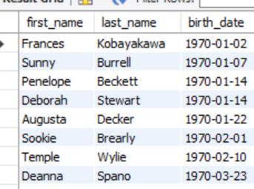
MEDICAL DATA HISTORY – SQL ANALYSIS
Show all patient's first_name, last_name, and birth_date who were born in the 1970s decade. Sort the list starting from the earliest birth_date.
Query
Out Put
SELECT first_name, last_name, birth_date
FROM patients
WHERE birth_date BETWEEN '1970-01-01' AND '1979-12-31’
ORDER by birth_date asc;

Slide 29

MEDICAL DATA HISTORY – SQL ANALYSIS
We want to display each patient's full name in a single column. Their last_name in all upper letters must appear first, then first_name in all lower case letters. Separate the last_name and first_name with a comma. Order the list by the first_name in decending order EX: SMITH,jane
Query
Out Put
Select
concat(upper(last_name),',’,
lower(first_name)) as full_name
from patients
order by first_name desc

Slide 30
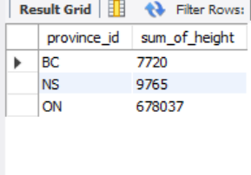
MEDICAL DATA HISTORY – SQL ANALYSIS
Show the province_id(s), sum of height; where the total sum of its patient's height is greater than or equal to 7,000.
Query
Out Put
SELECT
province_id,
SUM(height) AS sum_of_height
FROM
patients
GROUP BY
province_id
HAVING
SUM(height) >= 7000;

Slide 31
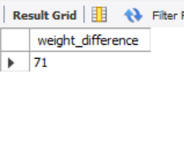
MEDICAL DATA HISTORY – SQL ANALYSIS
Show the difference between the largest weight and smallest weight for patients with the last name 'Maroni’
Query
Out Put
SELECT
MAX(weight) - MIN(weight) AS
weight_difference
FROM
patients
WHERE last_name='maroni';

Slide 32
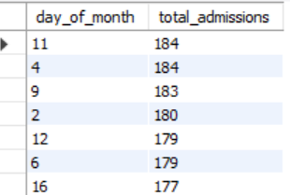
MEDICAL DATA HISTORY – SQL ANALYSIS
Show all of the days of the month (1-31) and how many admission_dates occurred on that day. Sort by the day with most admissions to least admissions.
Query
Out Put
SELECT
DAY(admission_date) AS day_of_month,
COUNT(*) AS total_admissions
FROM admissions
GROUP BY DAY(admission_date)
ORDER BY total_admissions DESC;

Slide 33
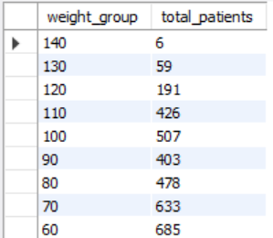
MEDICAL DATA HISTORY – SQL ANALYSIS
Show all of the patients grouped into weight groups. Show the total amount of patients in each weight group. Order the list by the weight group decending. e.g. if they weight 100 to 109 they are placed in the 100 weight group, 110-119 = 110 weight group, etc.
Query
Out Put
SELECT
(FLOOR(weight / 10) * 10) AS
weight_group,
COUNT(*) AS total_patients
FROM patients
GROUP BY weight_group
ORDER BY weight_group DESC;

Slide 34
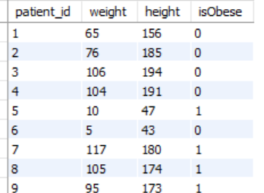
MEDICAL DATA HISTORY – SQL ANALYSIS
Show patient_id, weight, height, isObese from the patients table. Display isObese as a boolean 0 or 1. Obese is defined as weight(kg)/(height(m). Weight is in units kg. Height is in units cm.
Query
Out Put
SELECT
patient_id,
weight,
height,
CASE
WHEN weight / POWER(height / 100.0, 2) >= 30 THEN 1
ELSE 0
END AS isObese
FROM patients;

Slide 35
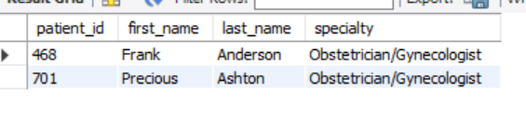
MEDICAL DATA HISTORY – SQL ANALYSIS
Show patient_id, first_name, last_name, and attending doctor's specialty. Show only the patients who has a diagnosis as 'Epilepsy' and the doctor's first name is 'Lisa'. Check patients, admissions, and doctors tables for required information.
Query
Out Put
SELECT
p.patient_id,
p.first_name,
p.last_name,
d.specialty
FROM patients p
JOIN admissions a
ON p.patient_id = a.patient_id
JOIN doctors d
ON a.attending_doctor_id = d.doctor_id
WHERE
a.diagnosis = 'Epilepsy'
AND d.first_name = 'Lisa';

Slide 36
THANK YOU
All required SQL queries were successfully executed,
and the medical dataset was analyzed to derive accurate, meaningful insights.
This project demonstrates the real-world application of SQL
in healthcare data analysis, focusing on data integrity, querying efficiency,
and insight-driven decision making.
Thank you for your time and attention.
Shaik Mezher Basha
Medical Data Analysis Using SQL

